Slide 1
Global health governance and Big Pharma in the age of crisis
Feyzi Ismail

Slide 2
Lecture outline
The current historical conjuncture
  Multiple crises: financial, climate, migration, health, pandemic etc.
  Understanding how they are linked and how global response is shaped
Two political economy approaches:
  Historicising our analysis
  Considering the imperialist dimensions of our analysis
The contemporary and historical role of global governance
The history of Big Pharma and its critique
Two broad approaches to global health governance
Imperialist implications in generating and responding to the health crisis

Slide 3
Learning objectives
By the end of this lecture, you should be able to…
  Distinguish between critical political economy and mainstream approaches to global health governance, including the implications of these approaches
  Describe the role of Big Pharma in global health governance, historical and contemporary, and its broad relationship to the IFIs
  Identify the imperialist dimensions of the global governance institutions and the role of Big Pharma

Slide 4
The pandemic is a portal…
The depth, scale, severity and unpredictability of the pandemic produced an unconventional response, bringing capital to a halt
  Social democratic reforms immediately put in place
    Exposed the types of labour that are crucial to the running of society
    Exposed the weaknesses of national healthcare systems everywhere
  Vaccine found in 9 months
  Revealed insights into how society could and needs to change
How do we link the current reality to prospects for change?

Slide 5
Global context
Current global context overwhelmingly characterised by multiple crises: financial, climate, migration, health, pandemic etc. exacerbated by privatisation, deregulation and social welfare cuts
  Crises have historical roots in colonialism, imperialism and a profit-driven system of production entrenching vast and growing inequalities
  What makes this historical conjuncture different: convergence and urgency
Global governance institutions inhibited by powerful economies
Imperialism and neoliberalism reinforce each other e.g. Chile

Slide 6
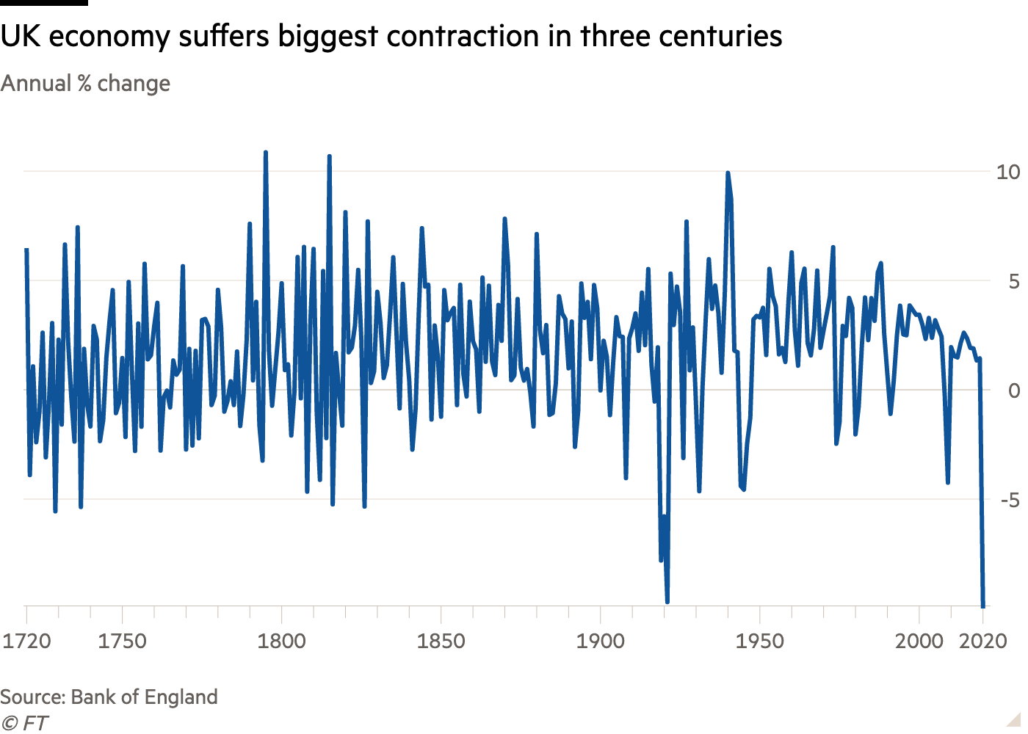
The heart of the system…

Slide 7
Connecting the crises
Financialisation and commodification of everything makes the crises interconnected and necessitates global solutions
The global governance institutions: to what extent are they legitimate and democratic? (Benedict, 2015)
  Market-based solutions of WB and IMF through structural adjustment
  WHO ill-equipped to deal with politics of global health inequality, only focused on threats of pathogens from LMICs (Benvenisti, 2020)
Dominance, power and ethics of Big Pharma in the Global South

Slide 8
Historical role of the IFIs
IFIs instrumental to 1970s neoliberal turn in LMICs
Loans made to LMICs since the 1980s on condition of removing subsidies and privatising healthcare and education etc.
  Officially voluntary but in reality imposed because of dependency
  IFIs’ market fundamentalism facilitated unequal access to healthcare
    Emphasis is on drug procurement rather than public health and prevention
Continuing to impose SAPs and austerity post-2008 constrains health policy and regulation at the expense of the poor everywhere

Slide 9
The history of Big Pharma
Roots in late 19th century: many pharma giants established
20th century: few state regulations for bringing drugs onto the market
Pharmaceutical companies always balanced between public health and private profit, pushing medical, ethical and legal boundaries
  Production of insulin and discovery of penicillin marks modern pharma
  Mass production of penicillin allowed rebranding of pharma (Posner, 2020)
1950s: pharmaceuticals the most profitable industry in the US
1970s: deregulation and new focus on blockbuster drugs for big profits
More emphasis now on genetics, immunotherapies, infectious diseases

Slide 10
The potential of Big Pharma?
Post-WWI, the industry was ruled by standards in drug production
Rational methods of mass production post-WWII enabled more systematic discoveries, R&D and technological optimism
  Contraceptives, anti-depressants, cancer drugs revolutionised society
Competition has increased but facilitated a number of innovations
  Tagamet, Prozac, AZT etc., gene therapies and new technologies have led to drugs for rare diseases previously considered untreatable
Is it possible to balance R&D, regulation and profit?

Slide 11
The global governance institutions and Big Pharma
Big Pharma accuses state regulators of violating rights of the sector
R&D for diseases specific to LMICs is inadequate because there is no market for the prices Big Pharma demands
  TRIPs subordinates role of WHO in coordinating global health
Expanding markets through export; ensuring local conditions for industry growth; seeking to lower costs (Applbaum, 2010)
WB and IMF revitalised sharp reductions in spending on public health through austerity (Sell and Williams, 2020)

Slide 12
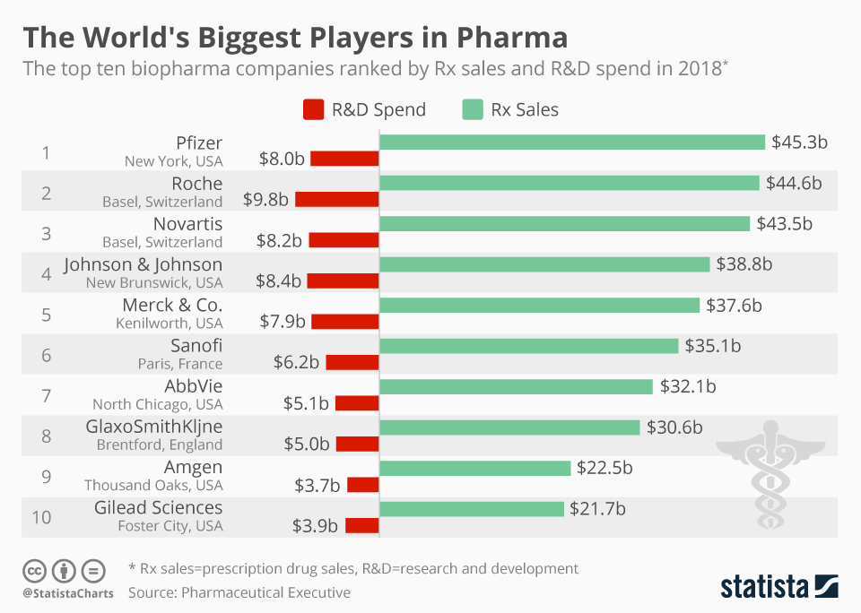
Profits vs. research & development

Slide 13
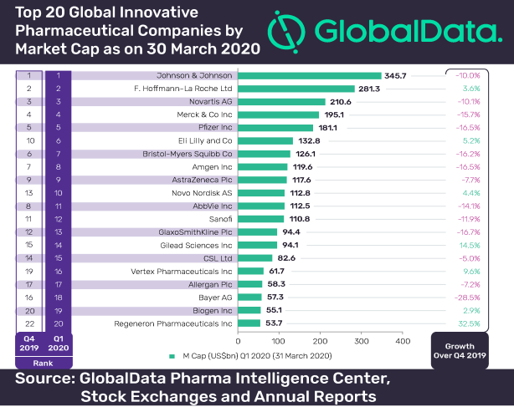
Revenues of top companies

Slide 14

The balance of power…

Slide 15
The significance of Big Pharma
Inordinate power, including the power to grant or deny health
  Only those drugs that have the potential for most profit are promoted
  Billions are spent on marketing to doctors and direct to consumers
    R&D budget amounts to a fraction of marketing and advertising budget
    Patents and monopolies enable companies to charge whatever they want
Reap private benefits of initial public investment by government
Innovation linked to intellectual property rights needs to be questioned and real sources of declining R&D identified

Slide 16
Two broad approaches to global health governance
Profit-driven: based on investing billions in R&D once government has taken initial steps and bringing scientific innovation to market
  Only Big Pharma has the financial capacity to invest at such scale as no government would
  Competition facilitates innovation and entrepreneurship
Need-driven: based on regulation, nationalisation, a focus on the public health of humans and nature, R&D, equitable access
  The public sector has consistently been the first to invest in high-risk innovations before the private sector e.g., university funding
  Government buys Big Pharma and separates market from health

Slide 17

Profit-driven: profit at the expense of global health
  Focuses on intellectual property and prioritises drugs that produce returns on investment
    Big Pharma was worth $1.4 trillion by end of 2020 (t’Hoen, 2020)
    Impedes innovation to tackle AMR
  Major implications for access and control in LMICs
    Patents make it difficult for generic drugs to come to market
  Market monopolies sustain prices well above production cost
(Image by …)

Slide 18
Example: COVAX Advance Market Commitment
Purpose is to raise funds from government and NGOs to distribute according to need rather than ability to pay
  Funds go directly to Big Pharma to invest in R&D and produce a vaccine that is affordable for all
  Questions over access, price and technology transfer remain
    Doesn’t work for Covid-19 because of levels of investment needed nor for AMR because antibiotics are only required in low doses and are cheap to produce
AMC mechanism designed to appease Big Pharma profits and provide incentives for private R&D

Slide 19
Example: India’s litigation battles
Profits of Big Pharma depend on preventing competition from generic drugs that can be accessed for a fraction of the price
  Indian drugs manufacturing post-1970 neutralised multinational patents through domestic legislation
    Indian Patents and Designs Act 1970 passed in the interests of national sovereignty
    Controls over 70% of domestic market and much of developing world needs
Nevertheless, this was a ‘battle between two versions of a marketized economy of health, neither of which met the needs of those who were suffering’ (Banerjee, 2017: 368)

Slide 20

Need-driven: global health for the sake of it
  Principle of separating healthcare from market imperatives and uncertainty
    No role for Big Pharma
  State regulation of healthcare as public good
    Free and universal access
  Good health connected to food system, technology etc.
(Image by …)

Slide 21
Example: Costa Rica’s proposed pooling mechanism
To facilitate access to and use of intellectual property, trade-secret know-how, regulatory data, cell lines, product blueprints, and other proprietary data for technologies that are useful for the detection, prevention, control, and treatment of COVID-19 (Abbas, 2020)
  Mobilises maximum available manufacturing or production capacity to improve affordable and universal supplies
  Licenses rights non-exclusively, royalty-free and on equitable terms
Inspired by the Medicines Patent Pool (MPP) involving collective management of patent rights, making drugs available at low or no cost to manufacturers that commit to produce and sell them in LMICs

Slide 22
Example: prospects for regulation
Eliminate monopolies on publicly funded health products
Maintain government control over patents
Enforce existing legislation on patents, government science and technology development and WHO mechanisms
  Issue government licenses for patented technologies
Ensure transparency of prices, profits, innovation and patents
  Abolish advertising direct to consumers and health officials
Prosecute companies and individuals who circumvent regulations

Slide 23
The need for global governance in crisis
Need global and internationalist responses to multiple crises
  Global governance institutions have a role to play in human welfare but need strengthening: WHO, OIE, FAO and others
  Institutions that undermine welfare and are dominated by imperialist states need regulation and then abolition: WTO, WB, IMF and others
Individual states and movements can challenge global governance on legal and political grounds
Institutional leadership is crucial but limited under capitalism

Slide 24
Imperialist implications
Multiple crises exacerbated by colonialism and imperialism and reinforcing class (race, gender etc.) divides between rich and poor
Imperialist dimensions of global health governance: e.g. Bill Gates
  Nationalism and imperialism facilitated by global governance; but neither expansionist markets nor international philanthropy are solutions for global problems e.g. climate crisis, pandemics etc.
Climate crisis originates in imperial conquest of labour and nature while pandemic emerges as consequence

Slide 25
Example: vaccine nationalism
Revealed in the early days of the pandemic with hoarding of PPE, ventilators, prohibiting exports, putting fear into populations etc.
Western nations secure priority access through advance purchase agreements (APAs), undermining equitable distribution
  Pre-production agreements reserving early supply before market entry; Operation WARP Speed: $10bn to eight pharma companies
Need enforceable global framework treating vaccines as global public goods, legal commitment to vaccine sharing, multilateral efforts towards development, access and distribution

Slide 26
Example: pharmaceutical stockpiling
Governments are more invested in pharmaceuticals for reasons of national security against health-based threats (Elbe et al., 2015)
  Bioterrorism and pandemics are deemed to require ‘medical countermeasures’ such as antivirals, vaccines, antibiotics etc.
  States are expanding security agendas by actively incentivising pharmaceutical companies to develop these countermeasures
    Involves stockpiling these countermeasures in defence against external threats
Policy interventions: public funding, legal protections for Big Pharma, regulatory approval, emergency use procedures and distribution systems
Nationalist interests increase geopolitical tensions

Slide 27
Example: patents and intellectual property
Patents and IPRs prohibit others from using invention for 20 years
Preferential access by imperialist countries to medicines, diagnostics and vaccines demonstrates power of states but also power of patent holders over key decisions about access to healthcare (McMahon, 2020)
  Private governance function by patent holders with no accountability towards citizens and no guarantees of access to key treatments
    Governments allow opaque governance networks to benefit pharmaceuticals
Where pandemics do not adhere to borders, the spread can only be contained by mandating disclosure of information and know-how through compulsory licensing, particularly in LMICs

Slide 28

Summary
Understanding the urgency of multiple and connected crises means unconventional measures
Internationalist response is necessary, which is neither nationalist nor competitive
Movements and politics – these are not unrelated to the kind of paradigm shift we need

Slide 29
Discussion questions
Banerjee (2017): To what extent can India’s example of imposing a constitutional obligation serve to undo the practices of Big Pharma? In other words, what is the role of state intervention in limiting the power of the industry, and what are its limits?
McMahon (2020): How do patents bestow a governance function to companies? What are some of the obstacles to implementing compulsory licensing, and what more regulation is needed?
Sell and Williams (2020): What are the corporate disease vectors that are producing a convergence of diseases between the Global North and LMICs? Should we abandon the focus on economic growth?

Slide 30
Bibliography
Applebaum, K. (2010) Marketing global health care: the practices of Big Pharma. Socialist Register, 46.
Benvenisti, E. (2020) The WHO – Destined to fail? Political cooperation and the Covid-19 pandemic. The American Society of International Law, 114(4): 588-597.
Benedict, A. (2015) Global Governance. International Encyclopedia of the Social & Behavioral Sciences, 155-161.
Abbas, M.Z. (2020) Treatment of the novel COVID-19: why Costa Rica’s proposal for the creation of a global pooling mechanism deserves serious consideration. Journal of Law and the Biosciences, 7(10).
Banerjee, D. (2017) Markets and Molecules: A Pharmaceutical Primer from the South. Medical Anthropology, 36(4): 363-380.
Elbe, S., Roemer-Mahler, A. and Long, C. (2015) Medical countermeasures for national security: A new government role in the pharmaceuticalization of society. Social Science & Medicine, 131: 263-271.
McMahon, A. (2020) Global equitable access to vaccines, medicines and diagnostics for COVID-19: The role of patents as private governance. Journal of Medical Ethics, 1-7.
Posner, G. (2020) Pharma: Greed, Lies, and the Poisoning of America. New York: Simon and Schuster.
Sell, S.K. and Williams, O.D. (2020) Health under capitalism: a global political economy of structural pathogenesis. Review of International Political Economy, 27(1): 1-25.
t’Hoen, E. (2020) Coronavirus: The Latest Problem Big Pharma Won’t Solve. Barron’s. Available at: https://www.barrons.com/articles/coronavirus-the-latest-problem-big-pharma-wont-solve-51581078600

