Slide 1
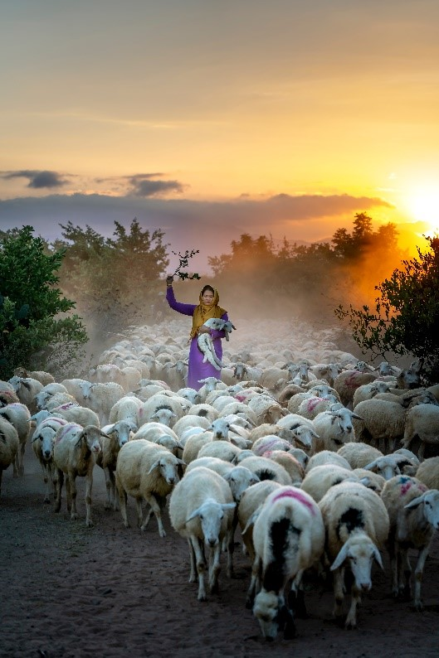
Markets and Global Value Chains
Dr. Mehroosh Tak

Slide 2
Learning objectives
By the end of this lecture, you should be able to…
Draw linkages between global capital, livestock value chains and disease outbreaks
Analyse the phenomenon of unequal ecological exchange for a country of their choice
Recognise the interconnections between economic liberalisation and global public health inequities
Describe global value chain (GVC) analysis approach

Slide 3
Circuits of Capital What do Covid-19, Ebola, palm oil and bats have in common? Go to www.menti.com and use the code 7093 4236
Notes:
Students to submit a word/phrase to answer this question using a mentimeter link. Lecturer will discuss response and point out the answer to be globalisation evidencing on the upcoming slides.

Slide 4
Context/ Background
At least 60% of novel human pathogens emerge by spilling over from wild animals to local human communities and then to rest of the world due to encroachment of natural wildlife spaces (Molyneus et al, 2011)
Notes:
Ask students why this may be the case? What are the mainstream reasons for this problem?

Slide 5
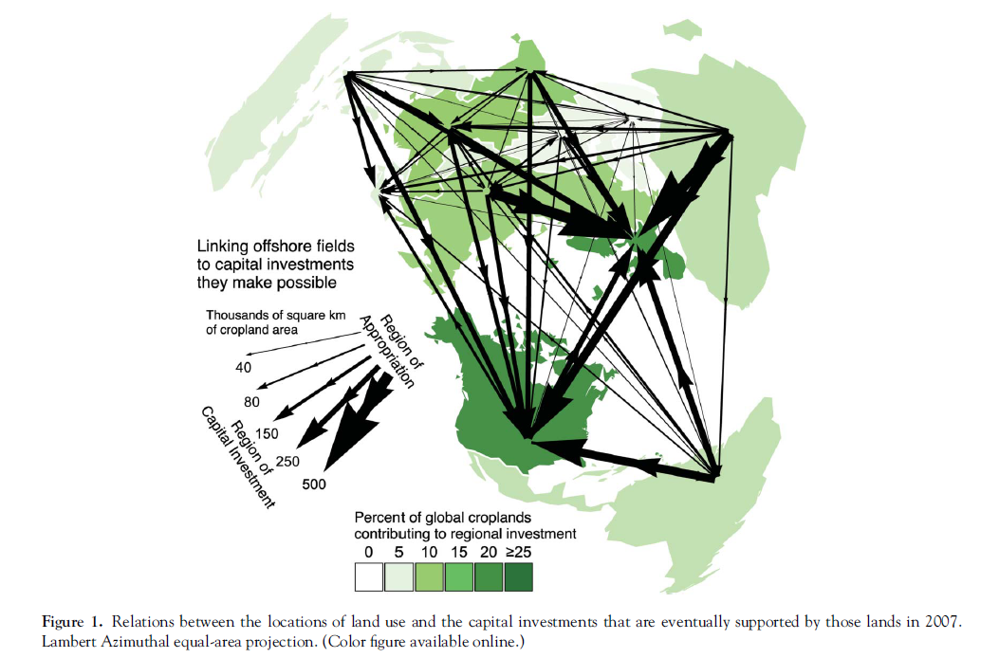
Source: Bergmann and Holmberg 2015
Notes:
Maps illustrate how uneven development under neoliberal globalization results in strong global net redistributions of various per capita benefits from land use, especially from Global South to Global North.
From the perspective of capital investment, the median square meter of global land use contributes to futures of human populations outside, not inside, of the country of that land

Slide 6
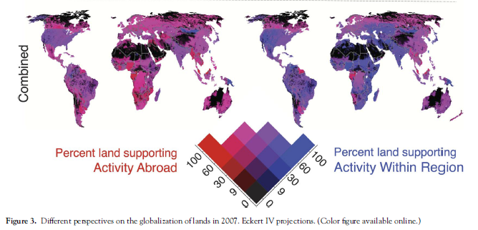
Capital Investment perspective
Consumption perspective
Source: Bergmann and Holmberg 2015
Notes:
Maps illustrate how uneven development under neoliberal globalization results in strong global net redistributions of various per capita benefits from land use, especially from Global South to Global North.
From the perspective of capital investment, the median square meter of global land use contributes to futures of human populations outside, not inside, of the country of that land

Slide 7
Unequal Ecological Exchange
Unequal ecological exchange – redirecting the worst damage from industrial agriculture to the Global South (Jorgenson 2006)
Increasing shift in use of forest land for feed crop production
Implications for ecological damage
More on land use shift in next lecture
Ecological spill over – Guinea palm oil plantations and bat habitat
North (consumption) – South(production) imbalance
Geographies of production and consumption
Circuits of capital → Landscapes and by extension pathogens globalise through circuits of capital, the source of disease may be beyond the country in which the pathogen first appeared (Rob Wallace et al)
Financialisation → is a process whereby financial markets, financial institutions and financial elites gain greater influence over economic policy and economic outcomes

Slide 8
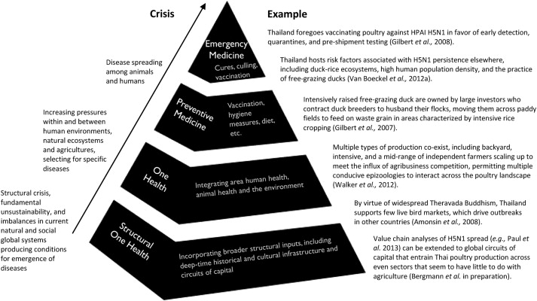
Structural One Health
Better understand how global capital in animal husbandry and land use produce interconnections that are related to disease emergence by
Empirically formalising connections between capital-led changes in the landscape and shifts in wildlife, agricultural, and human health
Identifying sovereign wealth funds , state owned enterprises, govt, private equity, pension funds etc finance the development and deforestation contributing to disease emergence
Source: Wallace et al 2015
Notes:
Structural OH - The new science, open to incorporating developments across the social sciences, addresses foundational processes underlying multispecies health, including the place-specific deep-time histories, cultural infrastructure, and economic geographies driving disease emergence.
Allows for conceptualizing how disease vulnerabilities emerge out of structural processes that, impacting ground zeros both directly and indirectly, may also originate distally in time, space and causality
Three postulates
Crisis differentiation
System lens
Interdisciplinarity

Slide 9
Breakout Session: Using a country of your choice, discuss whether the concept of unequal ecological exchange applies?

Slide 10
International Aid Did International Monetary Fund (IMF) contribute to the Ebola crisis? Why does the World Bank invest in private Indian poultry firms? How knowledgeable is Bill Gates about development policy?

Slide 11
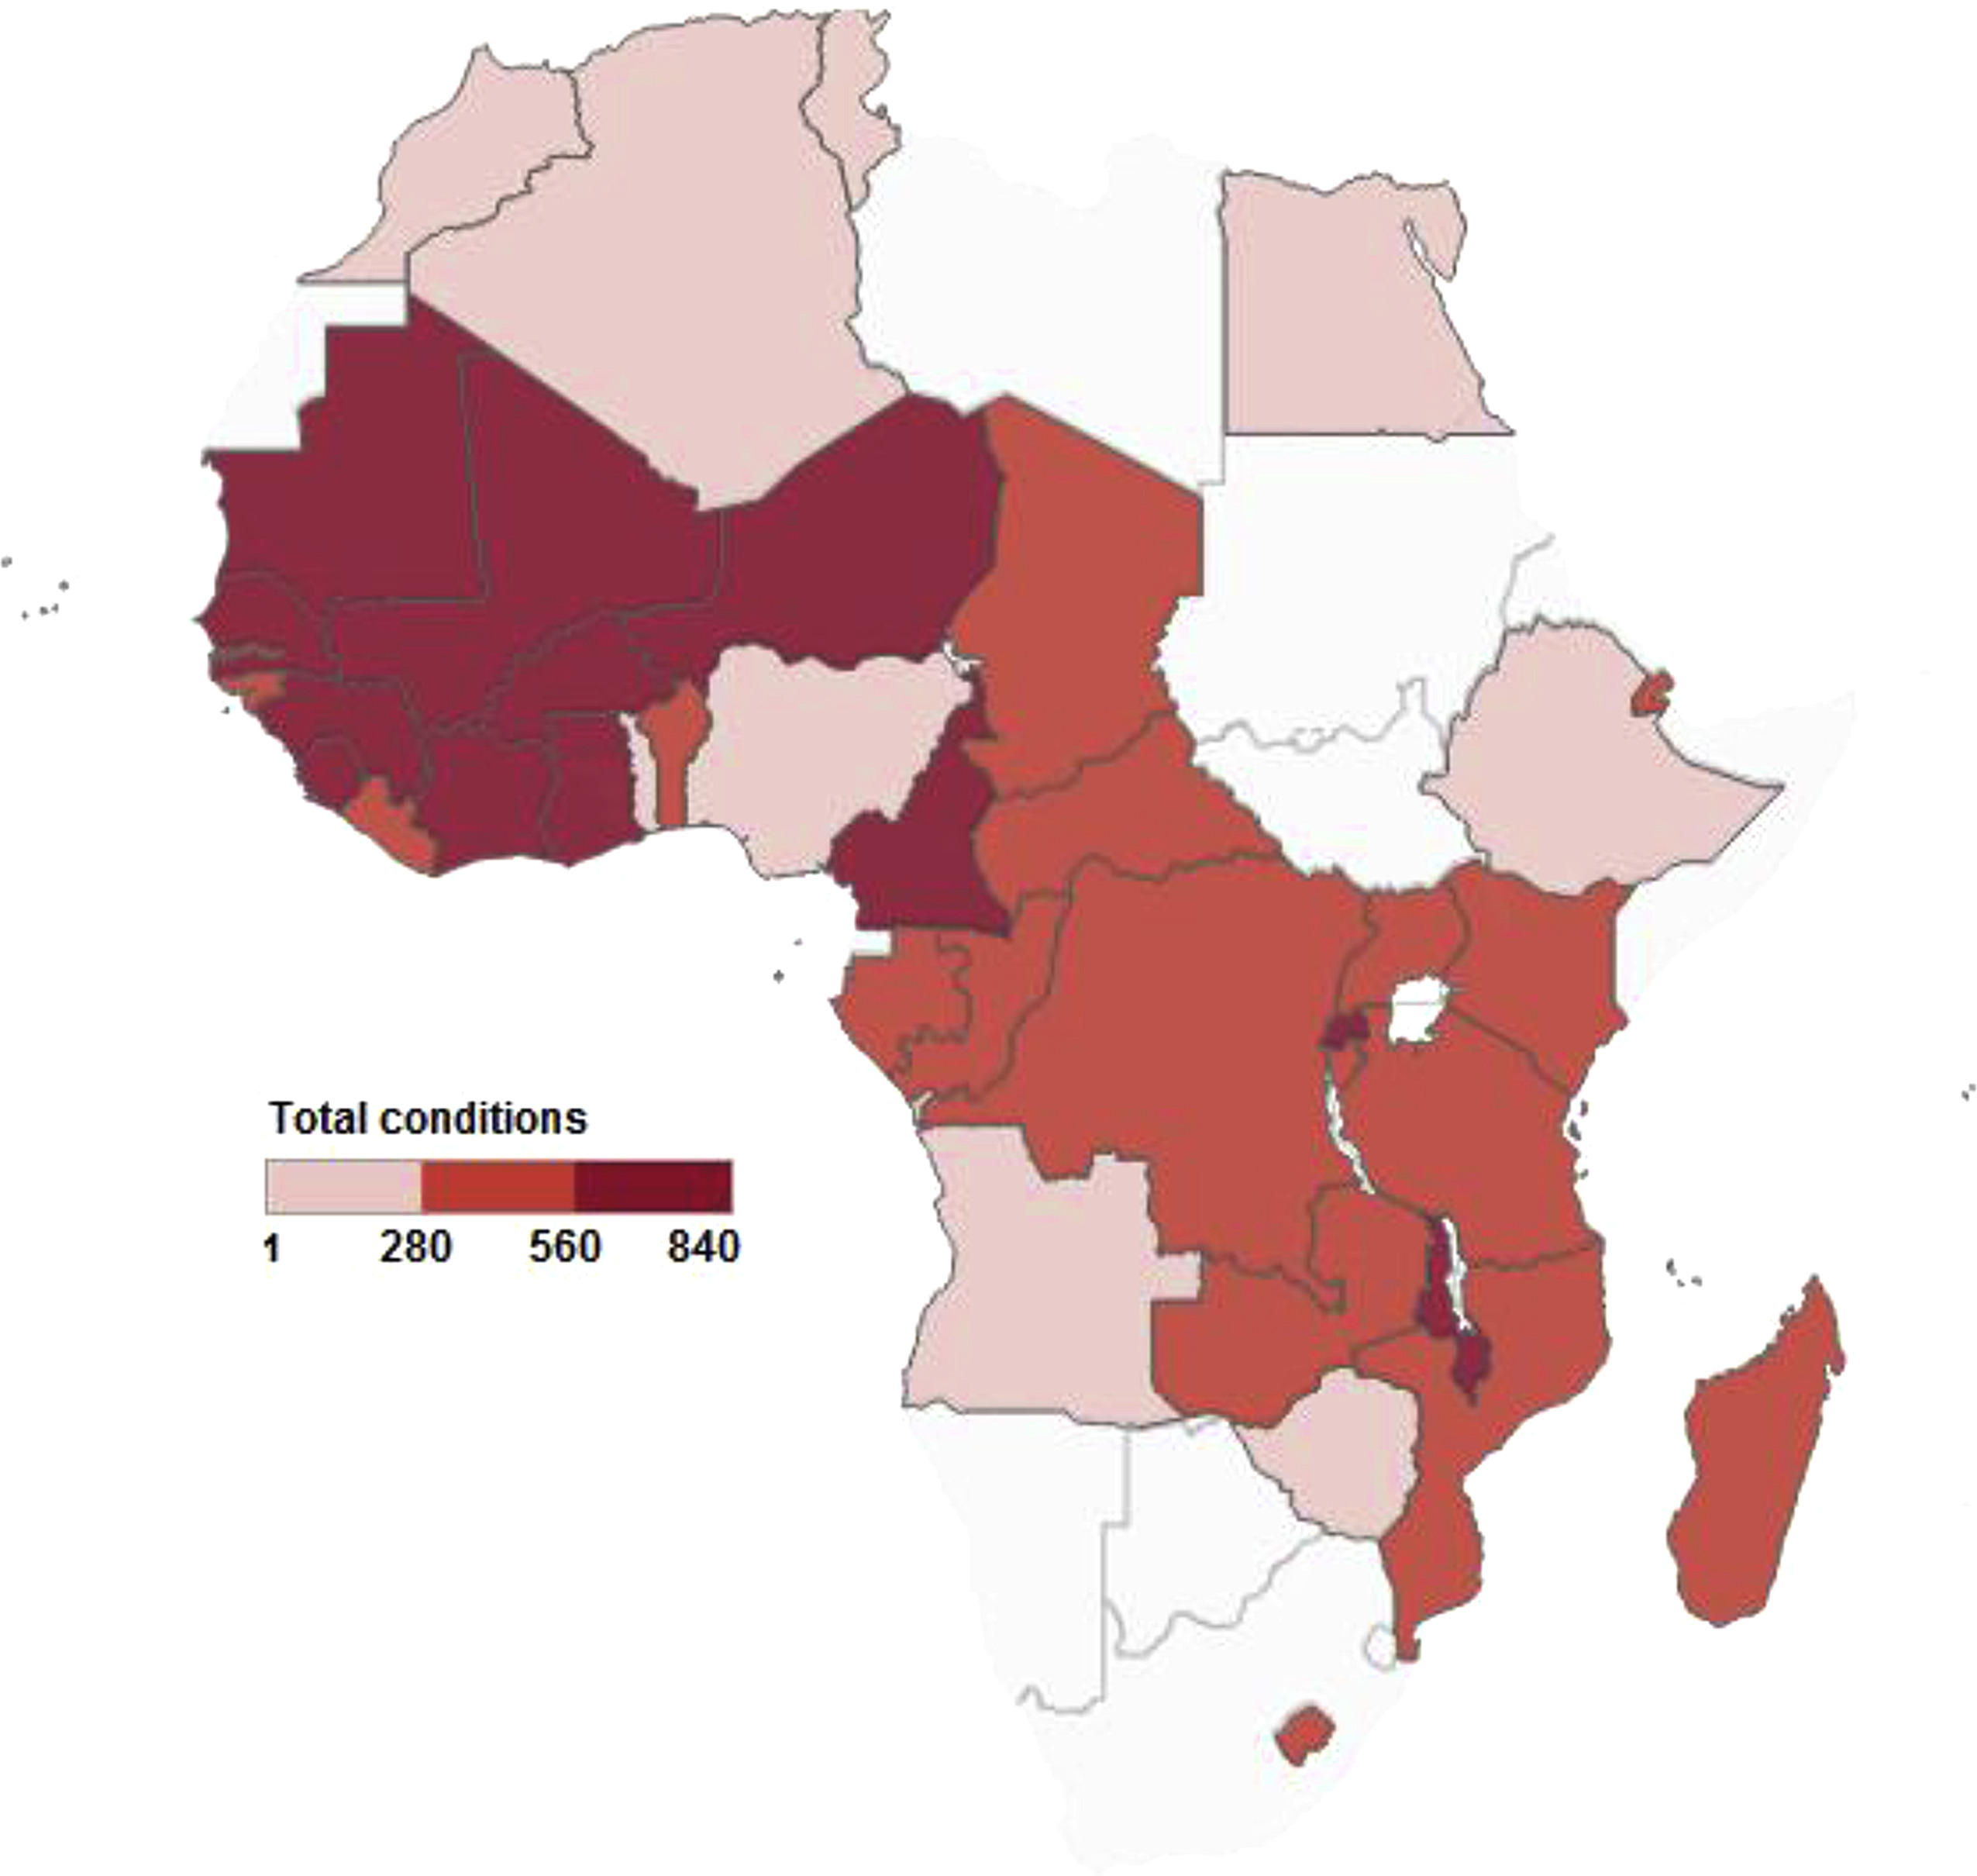
International Financial Institutions (IFIs)
International Monetary Fund (IMF)’s “conditionalities”
Prioritisation of short-term economic objectives over investment in welfare such as health and education (Stuckler D, Basu S. 2009, Goldsborough 2007) or poverty reduction
Washington Consensus: IMF and the World Bank have implemented multiple rounds of economic and debt reforms since the global economics crisis of 1930s
Structural Adjustment Programmes (SAPs) of the 1990s – reducing government spending, prioritisation of debt service, and bolstering of foreign exchange reserves – relying of trickle down effect – Case of India
Poverty Reduction Strategy Papers (PRSPs) – Case of South Africa
Good Governance Agenda – to reduce “corruption”
Caps on the public-sector wage bill – for public health sector workers and other civil servants - emigration of health personnel (McColl, 2008)
“Each additional binding IMF policy reform reduces government health expenditure per capita by 0.248 percent (95% CI −0.435 to −0.060). Overall, our findings suggest that IMF conditionality impedes progress toward the attainment of universal health coverage.” (Stubbs et al, 2017)
Notes:
WC- The prescriptions encompassed policies in such areas as macroeconomic stabilization, economic opening with respect to both trade and investment, and the expansion of market forces within the domestic economy. Consensus's emphasis on the opening of developing countries to global markets, and/or with what they see as an excessive focus on strengthening the influence of domestic market forces, arguably at the expense of key functions of the state
Alternative – South Korea

Slide 12
SAPs and Veterinary Services
Ghana 1980s (Amankwah et al, 2014)
SAPs were accompanied by reductions financial and human resources to public veterinary services, fragmenting service supply of prevention, clinical services, provision of drugs, vaccines, etc and human health protection
Preferential service to progressive (or wealthy) farmers
Non-adherence to international protocols for livestock health reporting
Cameroon late 1980s (Gros 1994)
Privatisation against the will of the national govt
Reduction in poorer farmers seeking vaccination services due to additional costs
No negative impact on large farmers to pay out of pocket
Notes:
Additional question: Veterinary services as public or private good
Discuss the strengths and weaknesses of veterinary services as public/private good in groups

Slide 13
IMF and Ebola
Case of Sierra Leone, Guinea, and Liberia (Kentikelenis et al, 2014)
Sierra Leone: Between 1995 and 1996, the IMF required the retrenchment of 28% of government employees, and limits on wage spending continued into the 2000s
Just before Ebola outbreak in 2013, 3 countries has achieved the IMF’s macroeconomic policy prescriptions, but failed to meet targets for social spending due to strapped public purses
Good governance agenda in Guinea: in 2000s IMF promoted fiscal and administrative decentralisation of health-care systems
IMF staff noted that the quality of health-service delivery had deteriorated

Slide 14
World Bank and Covid-19
Bank has announced a $14 billion package of fast-track assistance, and aims to deploy up a further $160 billion
Instead of using its Health, Nutrition, and Population Division, with its expertise in health, $8b of the $14billion will be channelled through the International Finance Corporation, the Bank's private sector financing arm
Source: World Bank Group launches first operations for COVID-19 (coronavirus) emergency health support, strengthening developing country responses. https://www.worldbank.org/en/news/press-release/2020/04/02/world-bank-group-launches-first-operations-for-covid-19-coronavirus-emergency-health-support-strengthening-developing-country-responses

Slide 15
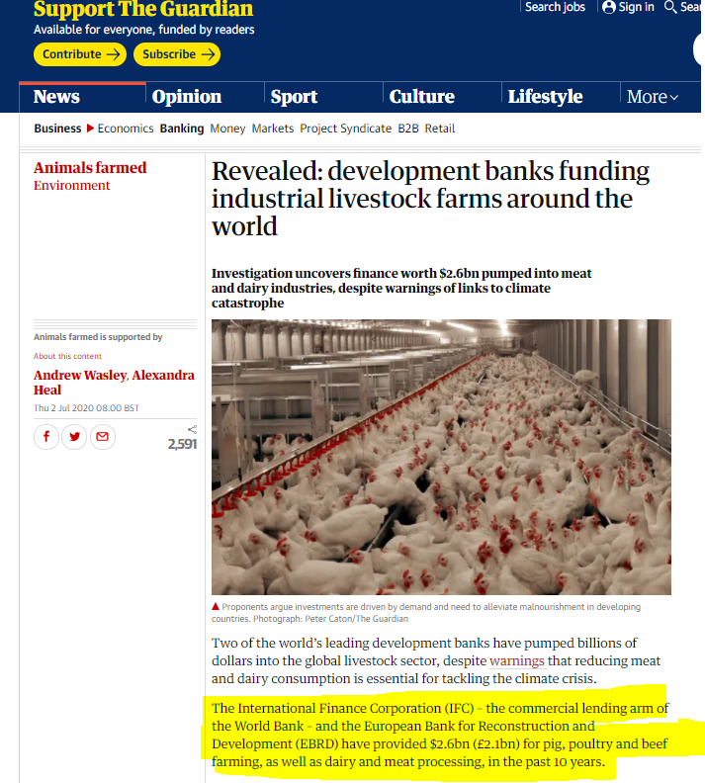
IFIs and Intensive Farming
The dairy sector was the biggest recipient of IFC and EBRD funding, with processing companies and farms receiving more than $1bn
The pig and poultry sectors each received about $500m
In 2020, IFC invests $54m to the India-based poultry giant Suguna, the country’s leading chicken supplier and one of the world’s top 10 biggest poultry producers
Suguna has 9,000 farms across 18 Indian states
IFC has also invested $20m in Srinivasa, Suguna’s competitor in 2018
Sources: Wasley and Heal, 2020

Slide 16
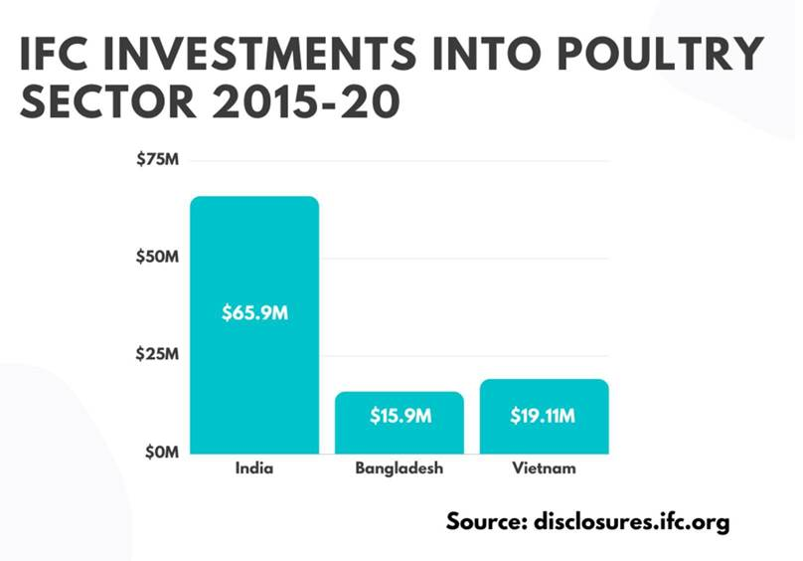
IFIs and Intensive Farming

Slide 17
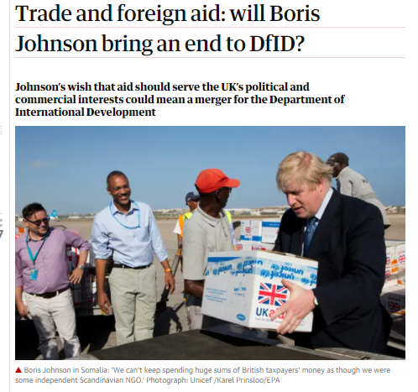
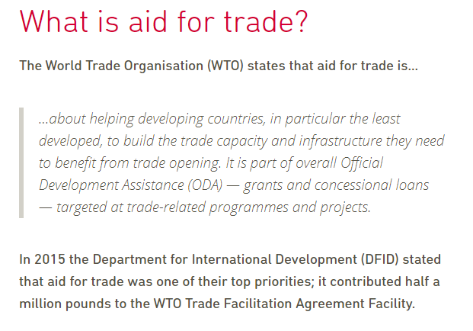
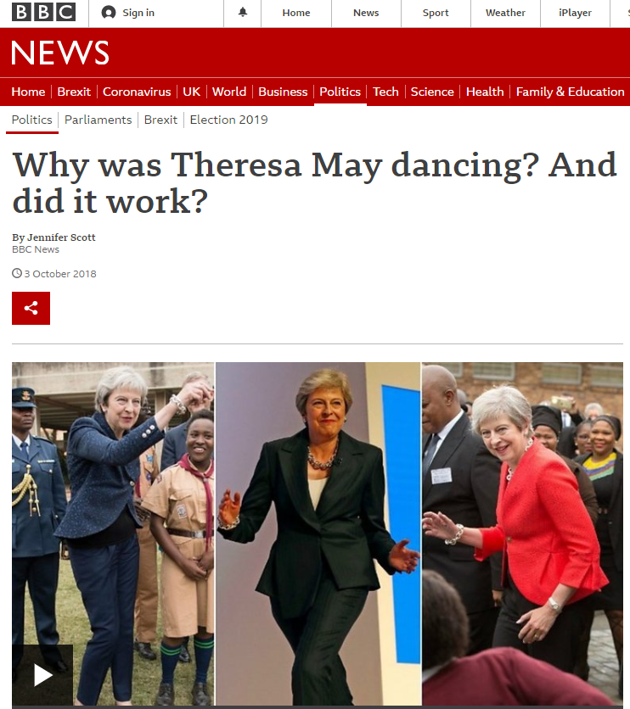
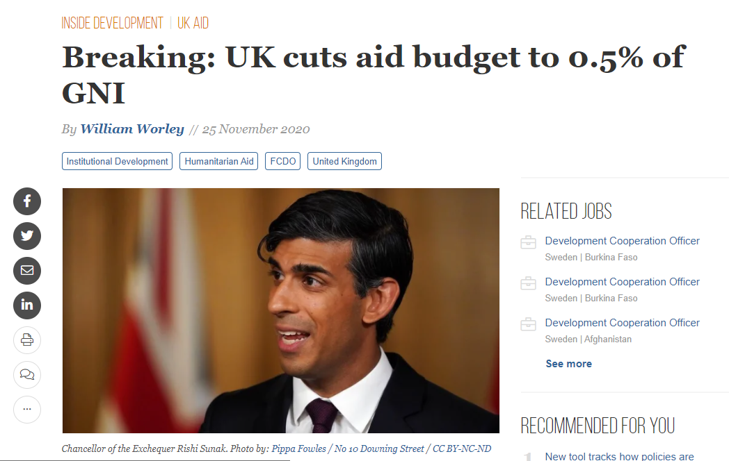
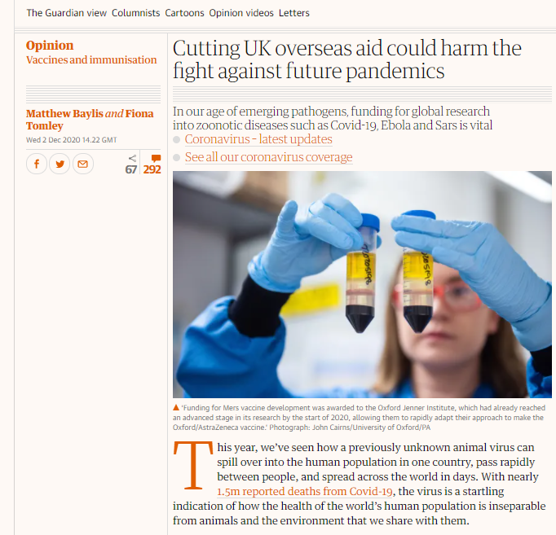
Aid for Trade: A form of conditionality?
Sources: https://www.bond.org.uk/news/2016/08/post-brexit-aid-policy-what-is-aid-for-trade-and-what-is-it-not
https://www.theguardian.com/commentisfree/2020/dec/02/cutting-uk-overseas-aid-pandemics-pathogens-zoonotic-covid-ebola-sars
Notes:
Discuss the conditionalities of DFID/FCDO on LMICs govt
1. https://www.theguardian.com/global-development/2019/jul/24/trade-foreign-aid-boris-johnson-dfid

Slide 18
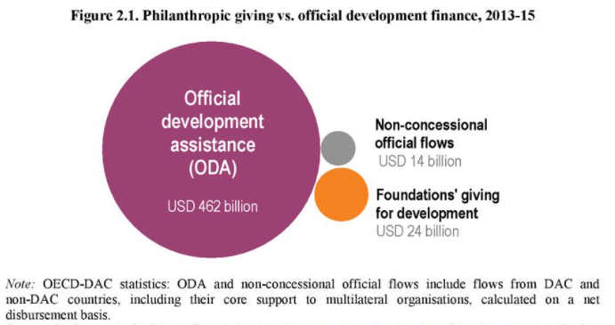
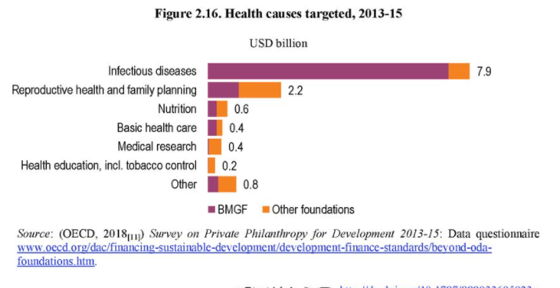
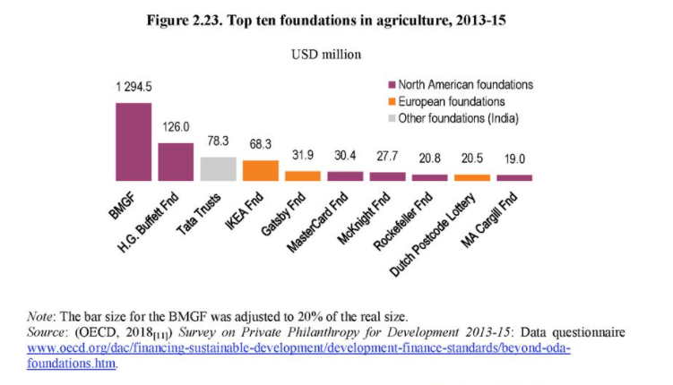
Non-Traditional International Aid
Notes:
https://www.oecd-ilibrary.org/sites/da5658fd-en/index.html?itemId=/content/component/da5658fd-en#section-d1e52192

Slide 19
Non-Traditional International Aid
Bill and Melinda Gates Foundation (BMGF) has been able to steer research and interventions in areas that the Foundation itself considers as top priorities, although these are not always the most important drivers of the disease burden within countries (Kentikelenis and Rochford, 2019)
BMFG’s technocratic approach - neglect of social determinants of health while promoting clinical technologies to deliver health improvement (McCoy et al, 2009)
Undermining local governance systems in LMICs (McCoy et al, 2009)
Notes:
The support of vertical, disease-based programmes can undermine coherent and long-term development of health systems, and its sponsorship of global health policy networks and think tanks can diminish the capabilities of Ministries of Health in low-income and middle-income countries.
the foundation’s generous funding of organisations in the UK and USA accentuates existing disparities between developed and developing countries while neglecting support for the civic and public institutional capacities of LMICs
Example: Gates Foundation partnered with the Coca-Cola Company (in which the Foundation is a major shareholder) to develop new business opportunities for farmers who sell fruit to the Company in Uganda and Kenya. According to the official narrative, this partnership would increase farmers’ incomes and also help fight hunger. However, the activities of the sugary drinks industry, including the Coca-Cola Company, have well-established links to unhealthy lifestyles and the incidence of obesity and other health problem

Slide 20
Plenary Discussion: 1. Did IMF contribute to the Ebola crisis? 2. Why does the World Bank invest in private Indian poultry firms? 3. How knowledgeable is Bill Gates about development policy?

Slide 21
Global Value Chains (GVC)

Slide 22
Global “Value” Chains
Global Commodity Chain analysis (GCC) studies power relations and interactions between firms within, and non-firm actors beyond, the value chain, and the developmental consequences of these new relationships on firms and regions in the Global South (Gereffi, 1990s)
Global Value Chain analysis (GVC) focuses on more detailed study of the relations between firms within the value chain (Gereffi, 2000s)
Global in GVC
Value chain analysis - An analytical tool
Unit of analysis is the chain, not the firm or country
Notes:
Global - In GCC terminology, the term ‘global’ is not meant to designate the geographical scope of the commodity chain, but refers instead to the distinction that Gereffi makes, following Dicken (1992), between internationalization and globalization. While the former ‘refers simply to the geographic spread of economic activities across national boundaries, “globalization” implies a degree of functional integration between these internationally dispersed activities’ (Gereffi 1994: 96). It is a premise of the GCC framework that contemporary globalization is characterized by transnational production systems that are increasingly integrated across space and coordinated through a variety of market and non-market forms, but it contains no specific definition of how ‘global’ such systems must be to qualify as global commodity chains. In fact, many studies of GCCs describe chains that are, at best, regional in scope – i.e. ‘North American’ chains with links in the United States and Mexico, or ‘European’ chains connecting activities in Germany and Romania. However, a GCC perspective would encourage analysis of how chains that are not necessarily global in scope are nevertheless configured by the dynamics of the larger lobal industries of which they are a part – for example, how regional production systems can be seen as a response to competitive pressures in the wider organizational field of a particular industry (Bair and Gereffi 2002). See Dicken et al. (2001) for a relevant discussion of spatial and scalar issues in the study of economic globalization.

Slide 23
Global “Value” Chains
A commodity chain refers to the whole range of activities involved in the design, production, and marketing of a product
Producer-driven commodity chains are those in which large, usually transnational, manufacturers play the central roles in coordinating production networks. This is characteristic of capital- and technology-intensive industries such as automobiles, aircraft, computers, semiconductors, and heavy machinery.
The automobile industry offers a classic illustration of a producer-driven chain, with multilayered production systems that involve thousands of firms (including parents, subsidiaries, and subcontractors).
Buyer-driven commodity chains refer to those industries in which large retailers, marketers, and branded manufacturers play the pivotal roles in setting up decentralized production networks in a variety of exporting countries, typically located in LMICs.
This pattern of trade-led industrialisation has become common in labour-intensive, consumer goods industries such as garments, footwear, toys, housewares, consumer electronics, and a variety of handicrafts. Production is generally carried out by tiered networks of LMIC based contractors that make finished goods for foreign buyers. The specifications are supplied by the large retailers or marketers that order the goods.
Retailers like Wal-Mart, athletic footwear companies like Nike and Reebok – companies design and/or market— but do not make— the branded products they order.
“manufacturers without factories”
Sources: Gereffi 1999 provides a deeper explanation

Slide 24
Global “Value” Chains – Key insights for livestock production
Economic upgrading
Concentration of market power
Economies of scale and globalisation of the food chain
The age of ‘factory farming’ / Confined animal feeding operations
As breeding grounds for disease and over use of antimicrobials
Importance of feed- grain-livestock complex for global agriculture
Emergence of flex crops
Increasing role of ‘standards’ and private regulation through contract farming for export in globalised trade

Slide 25
Economic Upgrading
Product upgrading
Moving into more sophisticated products with increased unit value
Chocolate instead of cocoa
Product differentiation - Marketing and branding as “value adds” and mechanisms of accumulation
Process upgrading
Achieving a more efficient transformation of inputs into outputs through the reorganization of productive activities
Functional upgrading
Acquiring new functions (or abandoning old ones) that increase the skill content of activities
Vertical coordination
Firms have more secure commercial agreements and contracts and integration within the chain
Notes:
Link back to AMR/ID

Slide 26
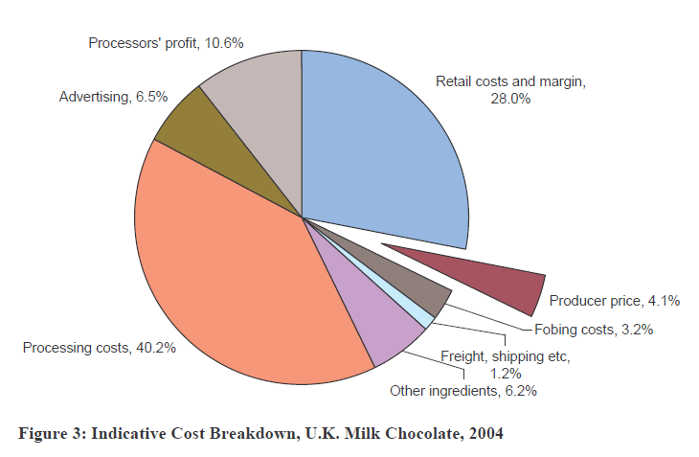
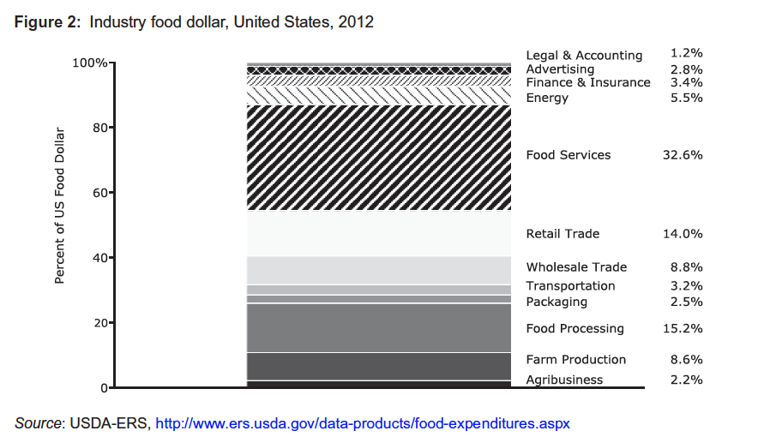
Product differentiation
Marketing and branding as “value adds” and mechanisms of accumulation
Source: Gilbert 2008

Slide 27
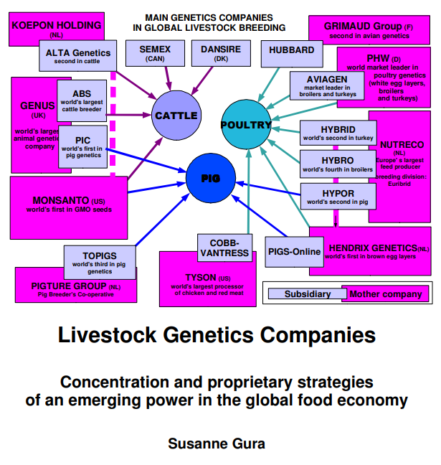
Concentration = Power?
Concentration of power
Fewer opportunities to upgrade

Slide 28
Economies of Scale
Case of
Pigs in China – Schneider (Wasting the rural: Meat, manure, and the politics of agro-industrialization in contemporary China)
Concentrated animal feeding operations (CAFOs)
Economies of scale captured through agribusiness development and vertical and horizontal integration. It refers to freeing land and labour in the countryside for capitalist production
Aquaculture in Asia – Ponte et al
Bangladesh shrimp and prawn value chains - fail to upgrade- “lower” quality product - signals inability of industry and government to improve – government subsidies that allow processing plants to continue to operate far below their capacity and provide no incentive to invest, and high levels of dependence on external donor funds

Slide 29
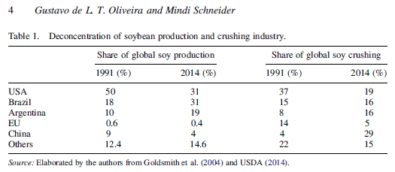
Flex Crops: Food to Feed
Flex crops
is a flex-investment. Where a single crop can be a diversified product portfolio.
Multiple options allow investors to speculate and gain leverage on the different uses of a crop (e.g. as biodiesel, detergent, or pharmaceutical)
Example: Turning soy into animal feed has a higher market value than say food, then production can be flexibly switched to the end-product that can bring in higher returns. Thus, as crops are targeted as investment opportunities; financial motives become increasingly significant in determining what crops are grown where, by whom and under what conditions.
Implications on land cultivation and biodiversity
China imports 37% of all soybeans trade and 19% of all trade in oilseeds in the world (Hansen and Jakobsen 2020).
68% of China’s production of maize goes into animal feed (Ely, Geall, and Song 2016)
Notes:
Bring back to AMR /ID due to intensification and lack of biodiversity. + unequal ecological balance

Slide 30
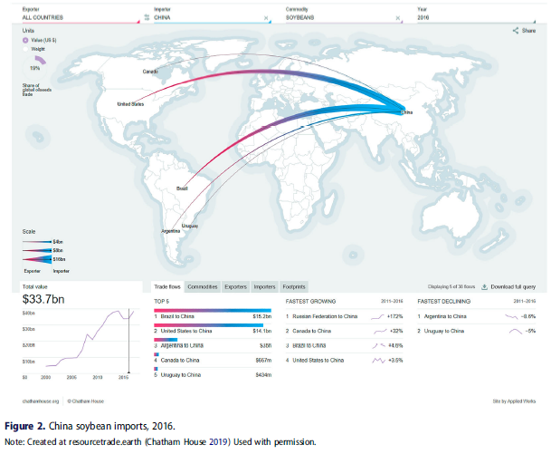
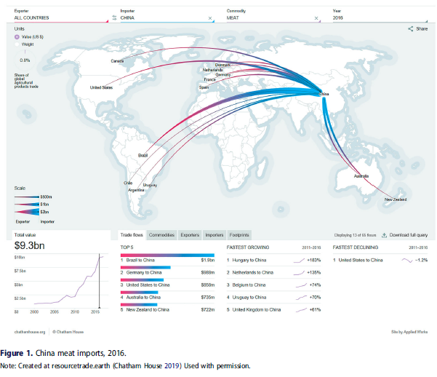
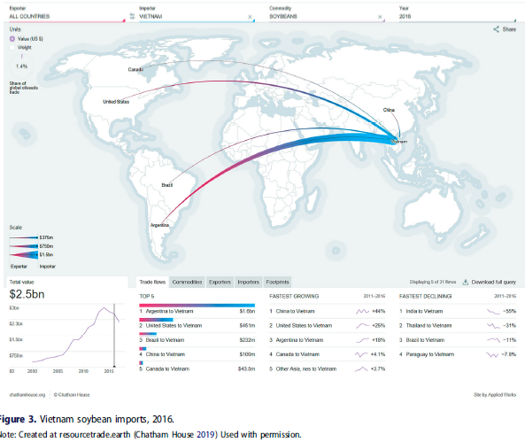
Case of Vietnam and China
While China is one of the biggest producers of meat, it is also an importer of both meat and feed inputs.
Source: Arve Hansen & Jostein Jakobsen (2020)

Slide 31
Export Standards
Guinea Palm Oil - “Discipline imposed by the biology of the industrialized tree”
Producers who brook their contracts were left with second generation palm trees that produced only 60% the oil of first generation seeds provisioned by the company (Delarue and Cochet, 2013)
Fish in Kenya and Tanzania - vertical integration into final processing for table fish value chain
But this upgrading proved unsustainable in the face of a raising of EU market entry barriers (Gibbon, 2001)
Why is relevant? Concentration of power!
More on this next week ☺

Slide 32
Global “Value” Chains
Why study GVC and how is it linked to livestock diseases and AMR?
Livestock production is increasingly becoming globalised and organised through value chains
To understand nature of global integration for producers in LMICs
To unpack how “value” is defined and distributed
More importantly how it is not defined or distributed
Environmental implications of GVCs - ‘thinking about production not as value creation but as a process of materials transformation in which environmental change and the organization/disorganization of matter and energy are integral rather than incidental to economic activity’ (Bridge, 2008, p. 77) – ie. Integrating ecology in “value” of GVC
Analysis of power concentration in GVCs helps to identify
Winners and losers of the global integration process
Potential for upgrading
Touchpoints/entry points for interventions for structural one health interventions

Slide 33
Conclusion
Links between global capital, banks, transnational corporations, philanthrocapitalism, food production, distribution, environmental and disease predisposition in LMICs

Slide 34
Bibliography example
Andrew K. Jorgenson, “Unequal Ecological Exchange and Environmental Degradation: A Theoretical Proposition and Cross-National Study of Deforestation, 1990–2000,” Rural Sociology 71, no. 4 (2006): 685–712
Luke Bergmann & Mollie Holmberg (2016) Land in Motion, Annals of the American Association of Geographers, 106:4, 932-956, DOI: 10.1080/24694452.2016.1145537
David Molyneux et al., “Zoonoses and Marginalised Infectious Diseases of Poverty: Where Do We Stand?,” Parasites & Vectors 4, no. 106 (2011).
Andrew Wasley, Alexandra Heal, 2 Jul 2020, Revealed: development banks funding industrial livestock farms around the world, The Guardian https://www.theguardian.com/environment/2020/jul/02/revealed-development-banks-funding-industrial-livestock-farms-around-the-world
Stuckler D, Basu S. The International Monetary Fund’s eff ects on global health: before and after the 2008 financial crisis. Int J Health Serv 2009; 39: 771–81.
Goldsborough D. Does the IMF constrain health spending in poor countries? Evidence and an agenda for action. Washington, DC: Center for Global Development, 2007. http://www.cgdev.org/page/does-imfconstrain-health-spending-poor-countries-evidence-and-agenda-action)
McColl K. Fighting the brain drain. BMJ 2008; 337: a1496
Alexander Kentikelenis, Lawrence King, Martin McKee, David Stuckler, 2014, The International Monetary Fund and the Ebola Outbreak. The Lancet Global Health
Kentikelenis, A., & Rochford, C. (2019). Power asymmetries in global governance for health: a conceptual framework for analyzing the political-economic determinants of health inequities. Globalization and health, 15(Suppl 1), 70. https://doi.org/10.1186/s12992-019-0516-4
Stubbs et al, 2017, The impact of IMF conditionality on government health expenditure: A cross-national analysis of 16 West African nations, Social Science & Medicine, Volume 174, February 2017, Pages 220-227
Gros, J.‐G. (1994), Of cattle, farmers, veterinarians and the World Bank: The political economy of veterinary services privatization in Cameroun. Public Admin. Dev., 14: 37-51. https://doi.org/10.1002/pad.4230140103
Kwadwo Amankwah, Laurens Klerkx, Owuraku Sakyi-Dawson, Naaminong Karbo, Simon J. Oosting, Cees Leeuwis & Akke J. van der Zijpp (2014) Institutional dimensions of veterinary services reforms: responses to structural adjustment in Northern Ghana, International Journal of Agricultural Sustainability, 12:3, 296-315, DOI: 10.1080/14735903.2014.909635
Arve Hansen & Jostein Jakobsen (2020) Meatification and everyday geographies of consumption in Vietnam and China, Geografiska Annaler: Series B, Human Geography, 102:1, 21-39, DOI: 10.1080/04353684.2019.1709217
Wallace et al, 2015, The dawn of Structural One Health: A new science tracking disease emergence along circuits of capital, Social Science & Medicine Volume 129, March 2015
Gilbert C. (2008) ‘Value chain analysis and market power in commodity processing with application to the cocoa and coffee sectors’ in Commodity Market Review, Rome: FAO, pp. 5-34. https://core.ac.uk/download/pdf/6262879.pdf
Jocelyne Delarue, Hubert Cochet. Systemic Impact Evaluation: A Methodology for Complex Agricultural Development Projects. The Case of a Contract Farming Project in Guinea. The European Journal of Development Research, 2013, 25 (5), p.778-796. https://halshs.archives-ouvertes.fr/halshs-01374496/document
Ponte, S., Kelling, I., Jespersen, K.S., Kruijssen, F. (2014), The Blue revolution in Asia: Upgrading and governance in aquaculture value chains, World Development, 64: 52-64 https://www.sciencedirect.com/science/article/pii/S0305750X14001430
Gary Gereffi, 1999, A Commodity Chains Framework for Analyzing Global Industries, Duke University, August 12, 1999
Susanne Gura (2007): Livestock Genetics Companies. Concentration and proprietary strategies of an emerging power in the global food economy. League for Pastoral Peoples and Endogenous Livestock Development, Ober-Ramstadt, Germany
Mindi Schneider 2017 Wasting the rural: Meat, manure, and the politics of agro-industrialization in contemporary China, Geoforum

